Slide 1
Project Objective:
SENTIMENT ANALYSIS ON YOUTUBE COMMENTS
The objective of this internship project is to perform entity-level sentiment analysis on YouTube comments using provided training and validation datasets. Given a comment and a specified entity (e.g., video ID or creator name), the task is to classify the sentiment of the comment as Positive, Negative, or Neutral, with messages irrelevant to the entity also categorized as Neutral.

Slide 2
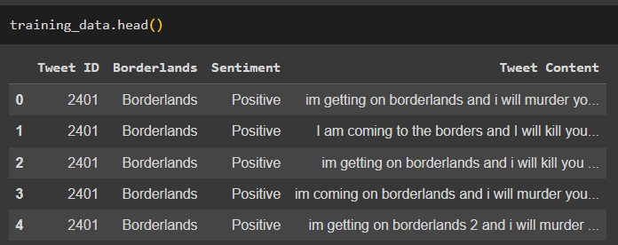
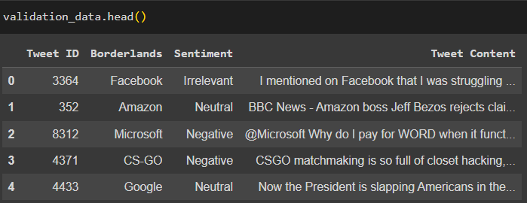
Training and validation datasets:

Slide 3
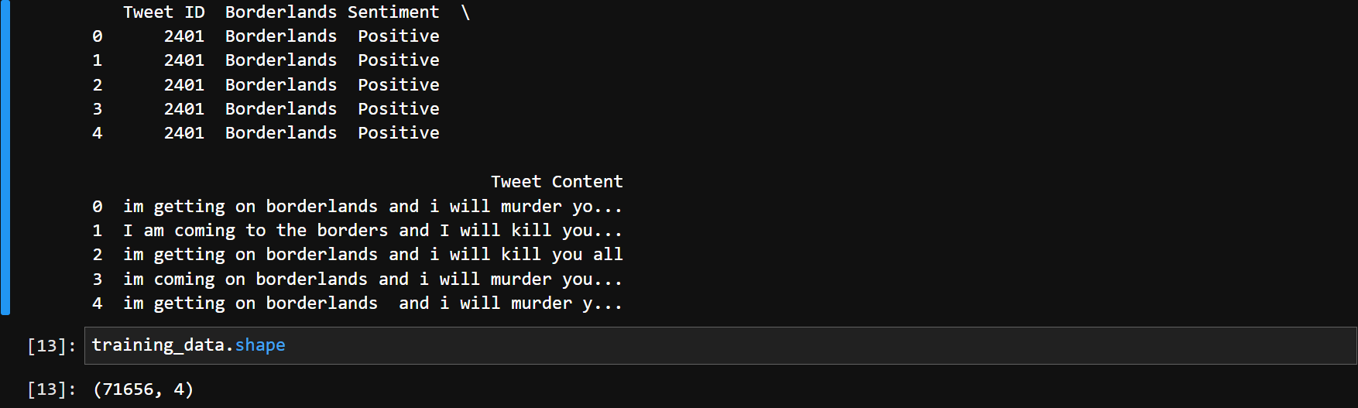
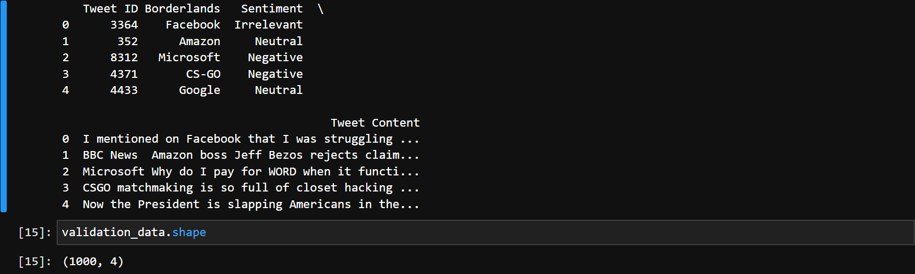
Data Preprocessing:
This is a step to clean the text data to handle noise, such as special characters, URLs, emojis, and missing or erroneous data, while retaining relevant textual information.
Load the training dataset with custom column names
Drop duplicate rows
Handle missing values/Drop rows with any missing values
Drop rows with duplicate values
Clean text data (Remove special characters, URLs, and emojis)
Display the first few rows of the cleaned dataset
Print pre-process data (training_data.head())
Output of Preprocessing:

Slide 4
Model Development:
To perform sentiment classification using TF-IDF (Term Frequency-Inverse Document Frequency), we need to vectorize the preprocessed text data. We'll use the TfidfVectorizer from scikit-learn to convert the text into numerical features. Here are the steps to do it:
Perform sentiment classification using TF-IDF (Term Frequency-Inverse Document Frequency), we need to vectorize the preprocessed text data. We'll use the TfidfVectorizer from scikit-learn to convert the text into numerical features. Here's how you can do it:
Initialize a TfidfVectorizer with a maximum of 5000 features. (This can be adjusted based on the size of the dataset and the complexity of the text)
Fit and transform the training data using fit_transform.
Transform the validation data using transform. It's important to note that same features learned from the training data are used to transform the validation data.
Finally, display the shape of the TF-IDF matrices to verify the dimensionality of the transformed data.
Display the shape of the TF-IDF matrices
This process converts the textual data into a numerical representation suitable for training machine learning models.
Output of Model Development:
The output indicates that the TF-IDF matrices have been successfully created for both the training and validation data, with a shape of (1000, 5000). This means that there are 1000 samples in each dataset, and each sample has been represented using a TF-IDF vector with 5000 features.
Note, the shape of the TF-IDF matrix (1000, 5000) represents the transformed representation of the text data after applying TF-IDF vectorization. It's different from the shape of the original datasets training_data.shape and validation_data.shape, which represent the number of rows and columns in the datasets before any preprocessing or feature extraction.

Slide 5
training machine learning models for sentiment analysis
Now that the TF-IDF matrices are ready for both the training and validation data, we can proceed with training the sentiment classification model with top-1 classification accuracy being the primary metric.
Two model selections are considered:
TF-IDF Vectorizer with ML Algorithm:
In this approach, we first convert text data into numerical vectors using techniques like TF-IDF (Term Frequency-Inverse Document Frequency).
These numerical vectors represent the features of the text data.
Then, we use traditional machine learning algorithms such as Logistic Regression, Random Forest, or Support Vector Machines to train a classifier using these numerical features.
The model learns patterns in the data and makes predictions based on these patterns.

Slide 6
Machine Learning Model cont’d
LSTM with TensorFlow Keras API:
In this approach, we use deep learning techniques, specifically Long Short-Term Memory (LSTM) neural networks.
LSTM networks are a type of recurrent neural network (RNN) architecture designed to work well with sequence data like text.
Instead of manually engineering features like with TF-IDF, the model learns to extract relevant features from the text data during training.
The LSTM model can capture long-term dependencies in sequences, making it well-suited for tasks like sentiment analysis where the order of words matters.

Slide 7
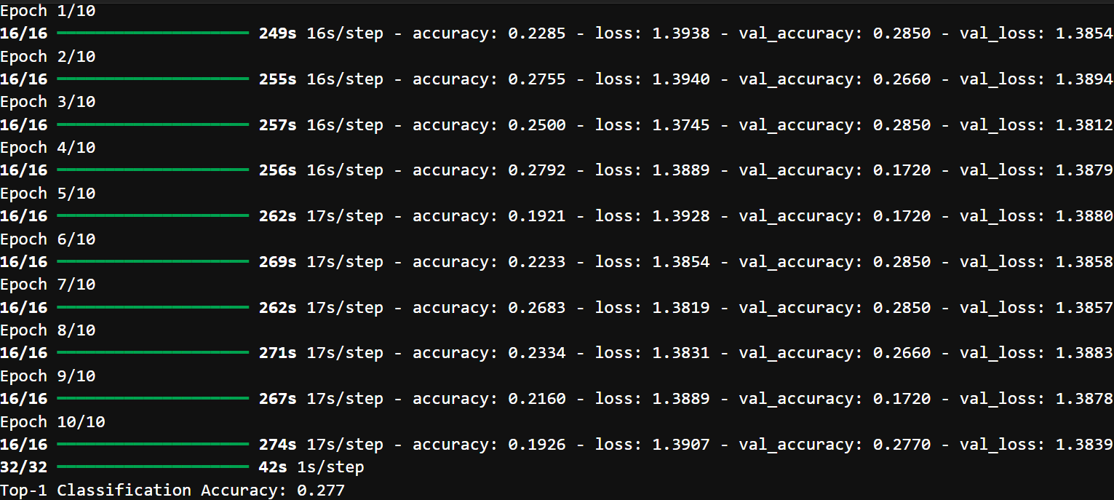
LSTM with TensorFlow Keras API (Output)

Slide 8
The performance of two different models for entity-level sentiment analysis on YouTube comments:
1) Model Development with TfidfVectorizer
Top-1 Classification Accuracy: 91.2%
Interpretation/Application:
This model achieved a high accuracy of 91.2% in classifying YouTube comments' sentiment towards specified entities using TfidfVectorizer for feature extraction and logistic regression for classification.
The high accuracy suggests that the model is effective in discerning sentiment in YouTube comments and can be utilized to analyze audience reception towards specific entities on the platform.
Content creators and marketers can leverage this model to gain insights into audience sentiment, helping them tailor their content strategies to enhance engagement and satisfaction.

Slide 9
The performance of two different models for entity-level sentiment analysis on YouTube comments:
2) Model Development with LSTM (TensorFlow):
Top-1 Classification Accuracy: 27.7%
Interpretation/Application:
This model achieved a lower accuracy of 27.7% in classifying sentiment using LSTM neural networks, indicating that it may not perform as well as the TfidfVectorizer-based model for entity-level sentiment analysis on YouTube comments.
The lower accuracy suggests that the LSTM model may not effectively capture the complex relationships and nuances present in YouTube comments compared to the TfidfVectorizer-based approach.
While LSTM models are capable of capturing sequential dependencies in text data, their performance may vary depending on factors such as dataset size, complexity of language, and model hyperparameters.
In summary, the TfidfVectorizer-based model outperformed the LSTM model in terms of classification accuracy for entity-level sentiment analysis on YouTube comments. Content creators and marketers can use the TfidfVectorizer-based model to gain valuable insights into audience sentiment and tailor their strategies accordingly to enhance engagement and satisfaction on the platform.

Slide 10
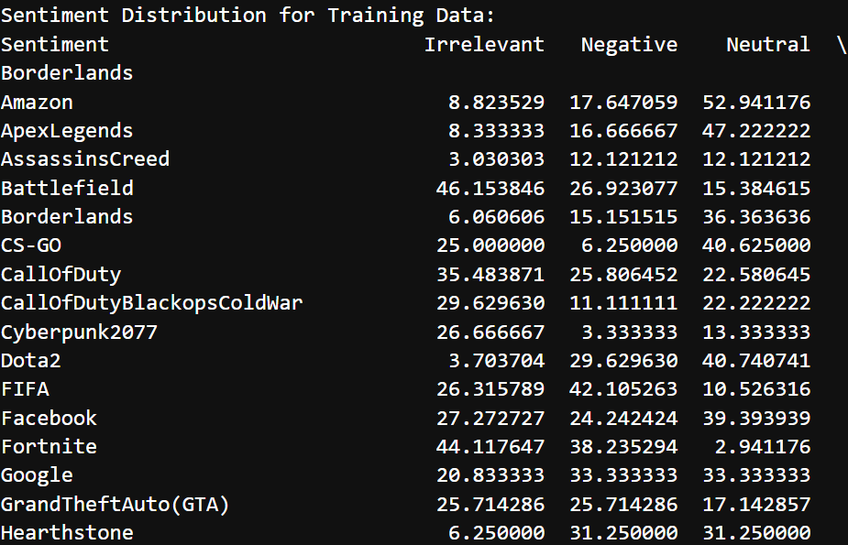
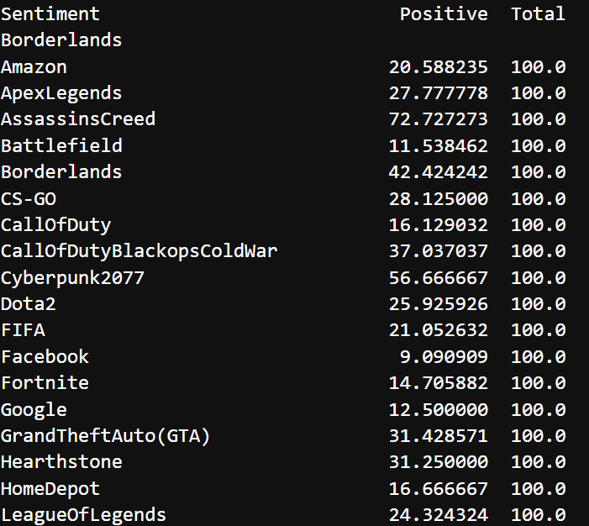
Sentiment Class Distribution cont’d

Slide 11
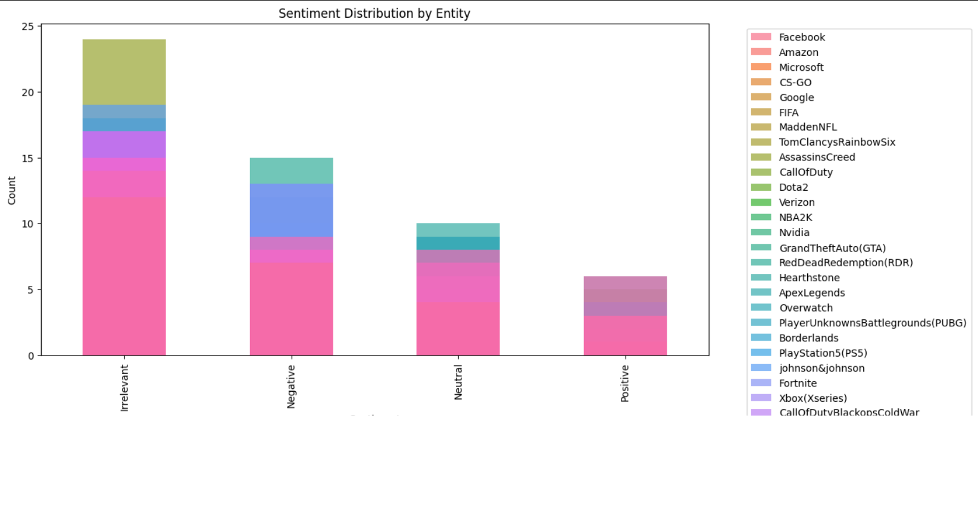
VISUALIZATION DASHBOARD Sentiment Distribution by Entity:

Slide 12
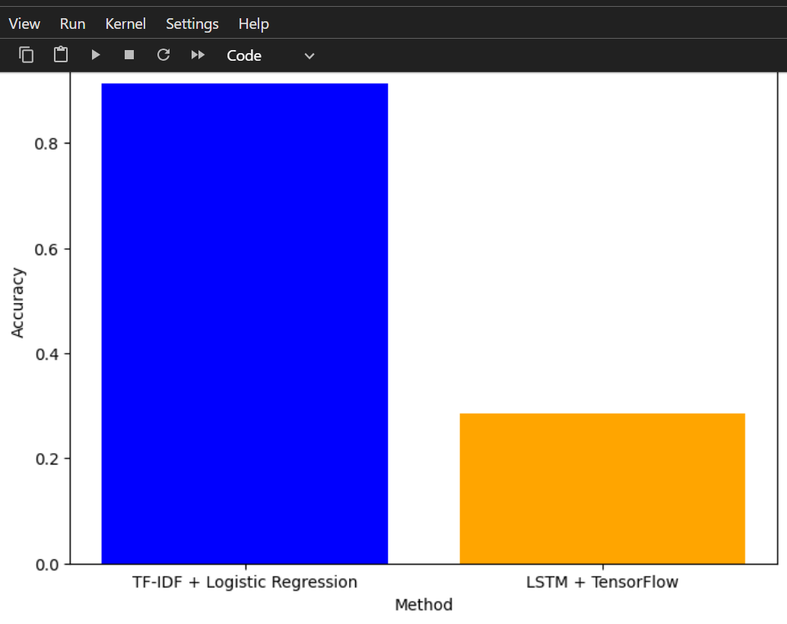
VISUALIZATION DASHBOARD Comparison of Sentiment Analysis Methods:

Slide 13
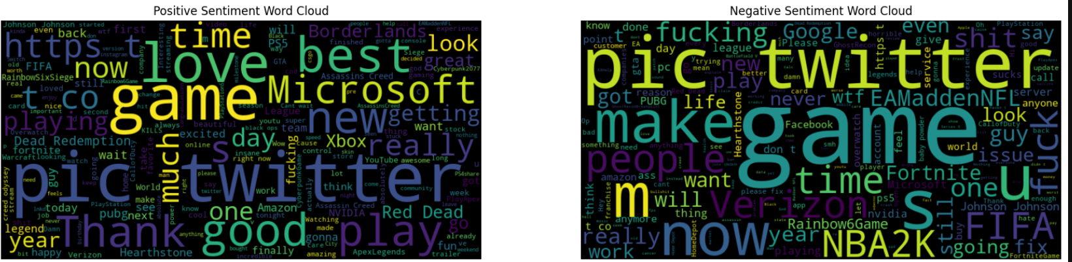
VISUALIZATION DASHBOARD Word Clouds cont’d

Slide 14
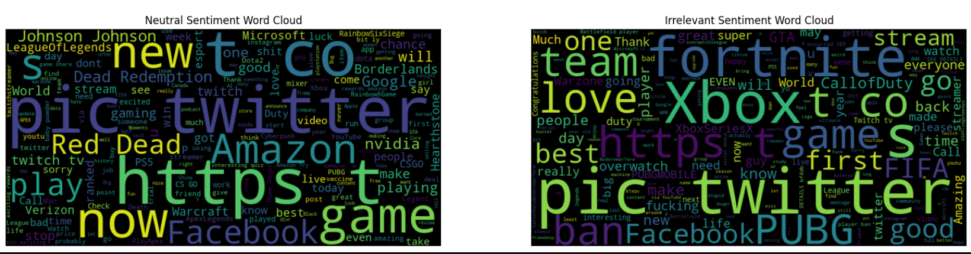
VISUALIZATION DASHBOARD Word Clouds cont’d

Slide 15
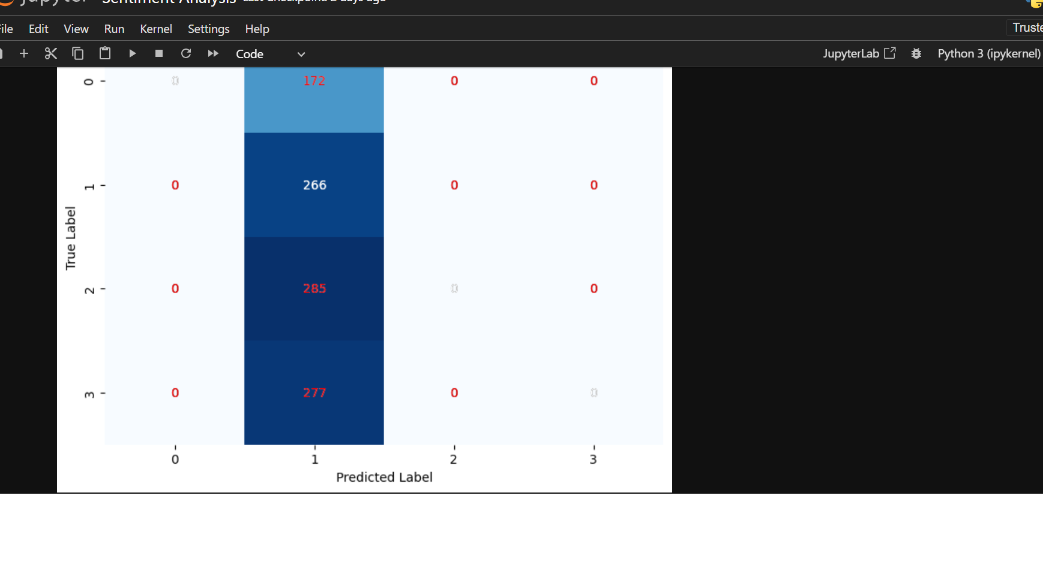
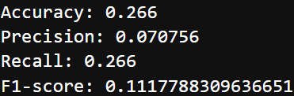
VISUALIZATION DASHBOARD Confusion Matrix cont’d

Slide 16
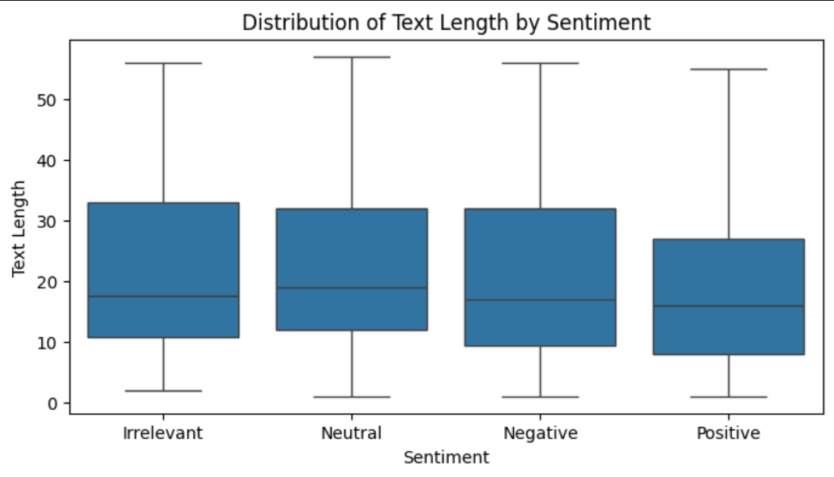
VISUALIZATION DASHBOARD Distribution of Text Length

Slide 17
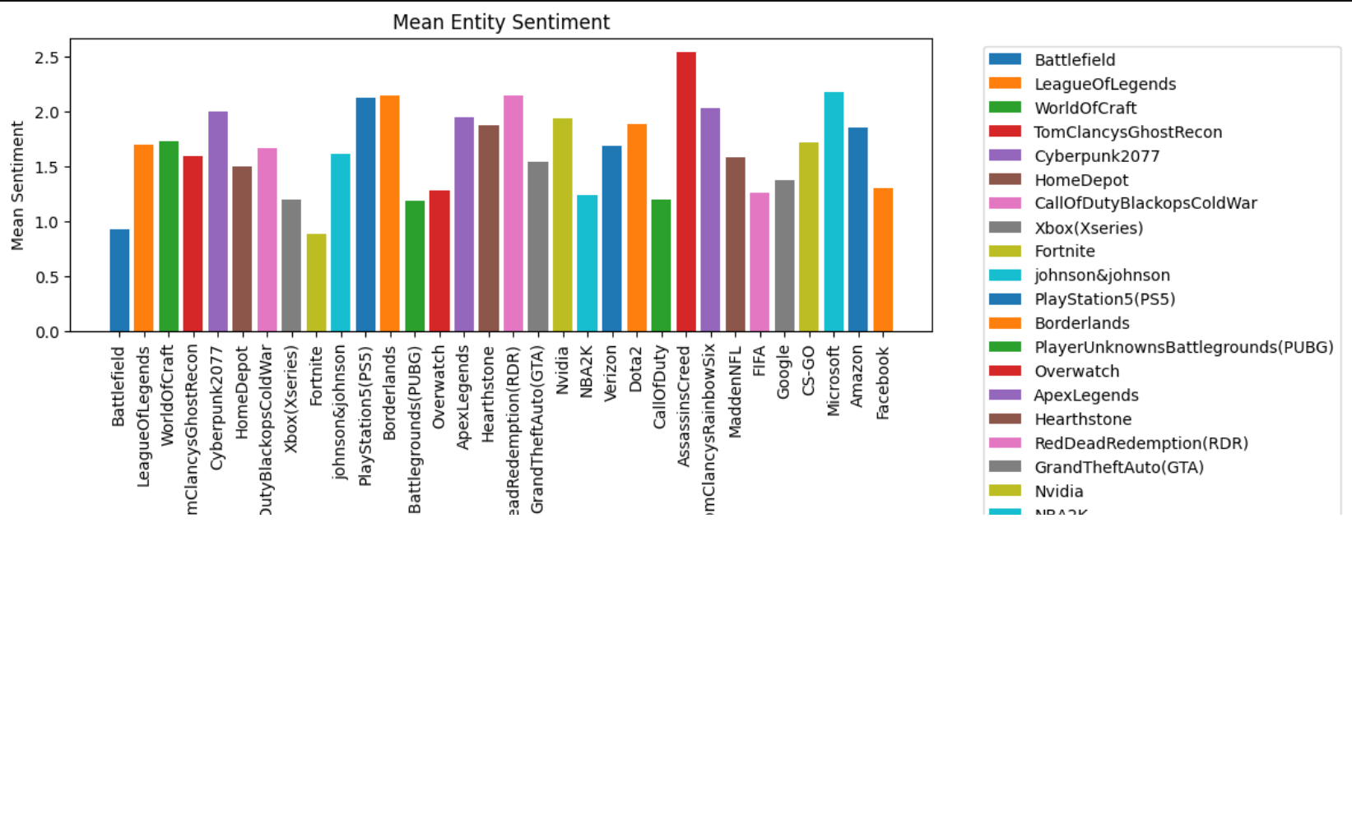
VISUALIZATION DASHBOARD Distribution of Text Length

Slide 18
Recommendations:
Based on the analysis findings, we can offer actionable recommendations to content creators or marketers to enhance engagement and satisfaction on YouTube. These recommendations could include:
1. Identifying popular topics or themes that generate positive sentiment and creating more content around them.
2. Content creators and marketers can use the TfidfVectorizer-based model(because of its higher Top-1 Classification Accuracy) to gain valuable insights into audience sentiment and tailor their strategies accordingly to enhance engagement and satisfaction on the platform.
3. Addressing common issues or concerns highlighted in negative sentiment comments to improve audience satisfaction.
4. Engaging with the audience by responding to comments, addressing feedback, and fostering a sense of community.
5. Experimenting with different content formats, styles, or delivery methods to better resonate with the audience.
6. Leveraging insights from sentiment analysis to tailor marketing strategies and promotional campaigns effectively.

Slide 19
Thank You

